Slide 1
COVID-19 MODELING April 6, 2020

Slide 2
Overview
Goal: Develop multiple forecasting perspectives
Oliver Wyman – Helen Leis
Columbia University – Professor Jeffrey Shaman, Ph.D.
Northeastern University – Professor Alessandro Vespignani, Ph.D.
Forecasting is imprecise:
Focus on the near term: Forecasting is much less predictable the further out you model
Focus on ranges rather than specifics: Forecasts are represented as a range of possible outcomes (i.e., likely, best & worst)
Consistent refinement: Continually updating with new data and new assumptions
Appropriate Perspective: Ultimately forecasts are developed for planning purposes and are not representative of definitive outcomes
Ultimate Purpose of Forecasting: Medical Surge Planning
Tracking the available staffed hospital beds
Tracking the available ICU beds
Tracking the available ventilators
Tracking the supply of PPE

Slide 3
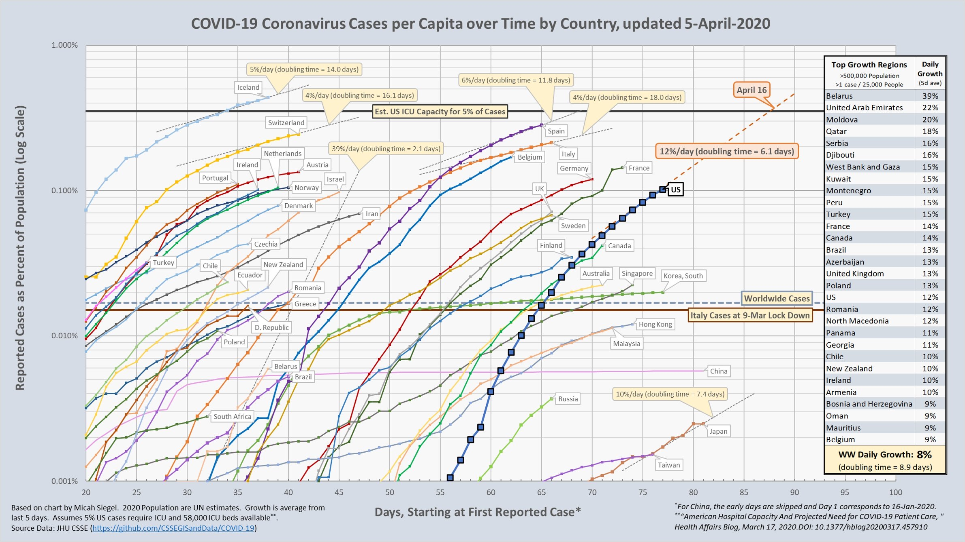
Comparison of Growth by Country

Slide 4
VT’s Growth Rate Compared to Northeast States

Slide 5
VT’s Growth Rate Compared to Northeast States

Slide 6
Vermont’s Daily COVID-19 Confirmed Case Growth
Source: Vermont Department of Health
~5.5 days +
Days until confirmed cases double
~3 days

Slide 7
Vermont’s Daily Growth Rate Compared to Total Cases
Source: Vermont Department of Health
Note: This chart notes the stability of Vermont’s case growth rate as we approached and surpassed 100 confirmed cases.
Percentage of Case Growth
Number of Cases

Slide 8
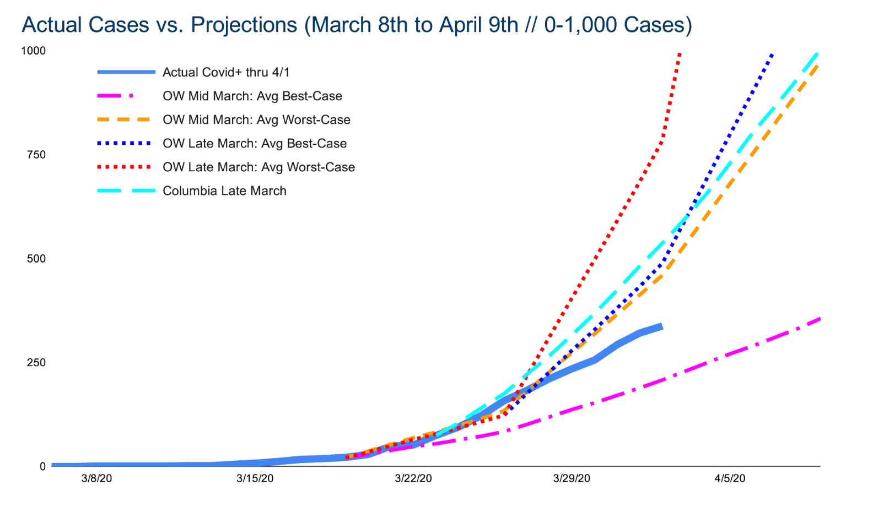
Close Look at Forecasting vs. Actual Case Count

Slide 9
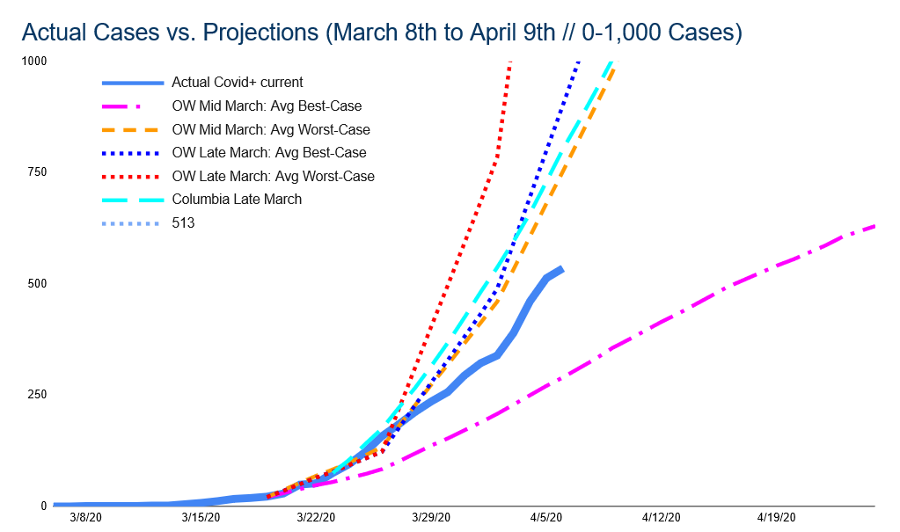
Close Look at Forecasting vs. Actual Case Count

Slide 10
Days Until the Impact of Social Distancing is Seen
Closing Schools
Closing Bars & Restaurants
10 to 14-day delay in effect
State of Emergency
Stay Safe Stay Home – 14 days
March 24th – April 8th

Slide 11
Total Vermont Testing Over Time

Slide 12
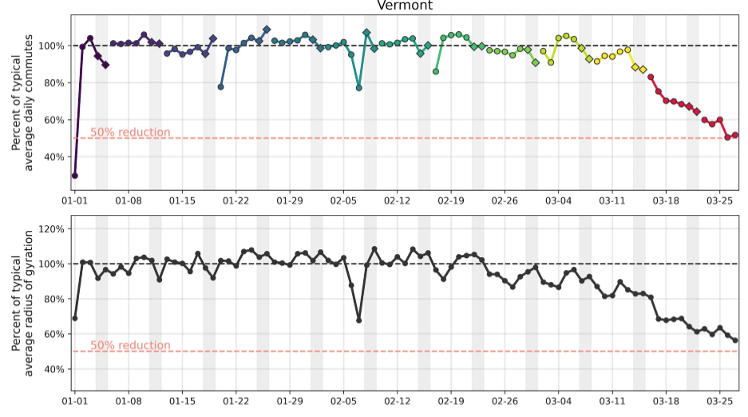
Vermont’s Mobility Reductions
Key Points:
1 : 50% Reduction in physical movement with mitigation policies in place
2. Dip on Feb 7 is the snowstorm; this means people are moving around LESS than they did during the big snowstorm → this is very good
1
2
Emergency Declaration
3/13
Stay at Home
3/24
1
2
Snow storm
Source: Dr. Vespignani, Northeastern University

Slide 13
Hospitalization Needs – Likely, Best & Worst
Note – Late March Trajectory
* April 2nd: 29 patients hospitalized

Slide 14
ICU Needs – Likely, Best & Worst
Note – Late March Trajectory
* April 2nd: 8 patients in ICU

Slide 15
Ventilator Needs – Likely, Best & Worst
Note – Late March Trajectory
* April 2nd: 1 patient needing ventilation

