Slide 1
COVID-19 MODELING April 17, 2020

Slide 2
Overview Presentation Updated Through April 16, 2020
Goal: Develop multiple forecasting perspectives
Oliver Wyman – Helen Leis
Columbia University – Professor Jeffrey Shaman, Ph.D.
Northeastern University – Professor Alessandro Vespignani, Ph.D.
University of Washington – Institute for Health Metrics and Evaluation (IHME)
UVM – Larner College of Medicine – Department of Microbiology & Molecular Genetics – Traslational Global Infectious Disease Research (TGIR) Group – John Hanley, PhD
Forecasting is imprecise:
Focus on the near term: Forecasting is much less predictable the further out you model
Focus on ranges rather than specifics: Forecasts are represented as a range of possible outcomes (i.e., likely, best & worst)
Consistent refinement: Continually updating with new data and new assumptions
Appropriate Perspective: Ultimately forecasts are developed for planning purposes and are not representative of definitive outcomes
Ultimate Purpose of Forecasting: Medical Surge Planning
Tracking the available staffed hospital beds
Tracking the available ICU beds
Tracking the available ventilators
Tracking the supply of PPE

Slide 3
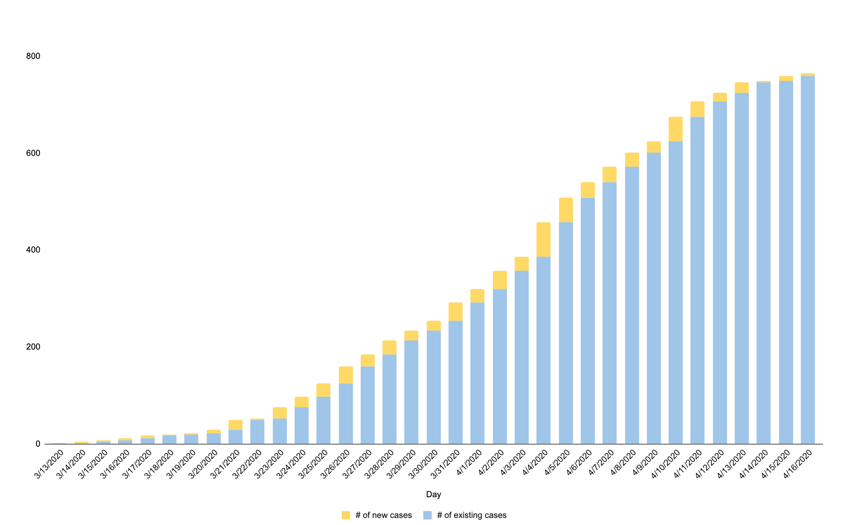
Vermont’s Daily COVID-19 Confirmed Case Growth
Source: Vermont Department of Health
Days until confirmed cases double
Not estimated to double for ~27 days
~7.5 days
~5.5 days
~3 days
~3 days
~3 days

Slide 4
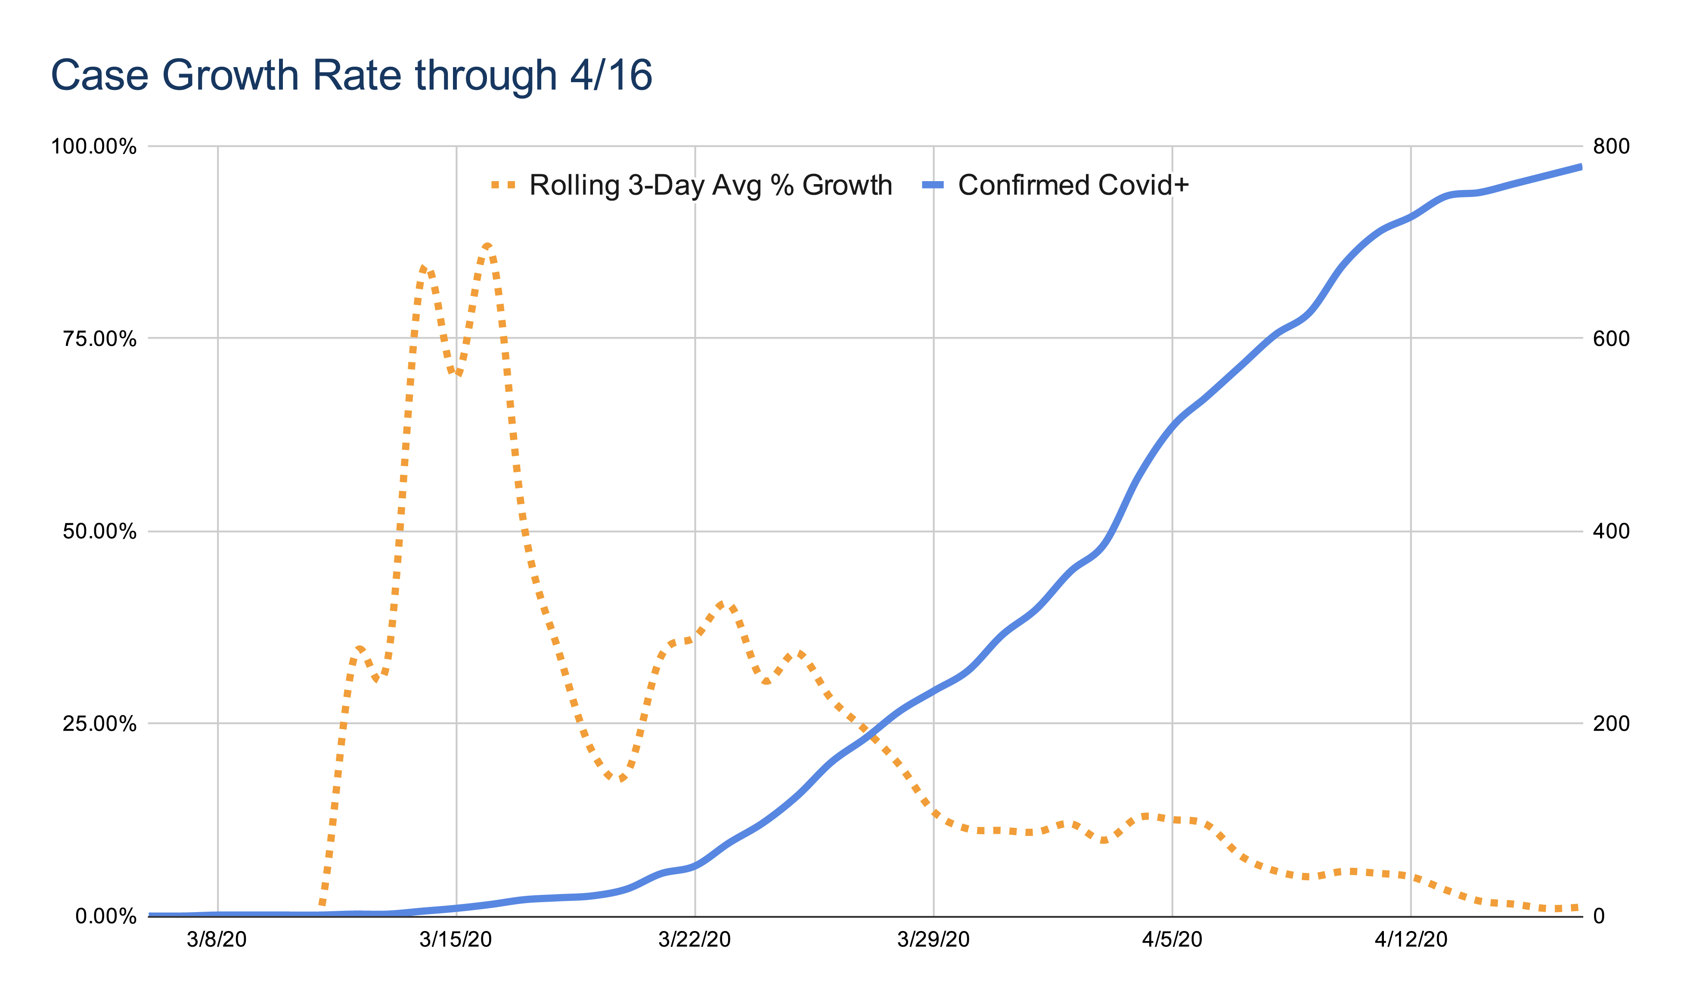
Vermont’s Daily Growth Rate Compared to Total Cases
Source: Vermont Department of Health
Note: This chart notes the stability of Vermont’s case growth rate as we approached and surpassed 100 confirmed cases.
Percentage of Case Growth
Number of Cases

Slide 5
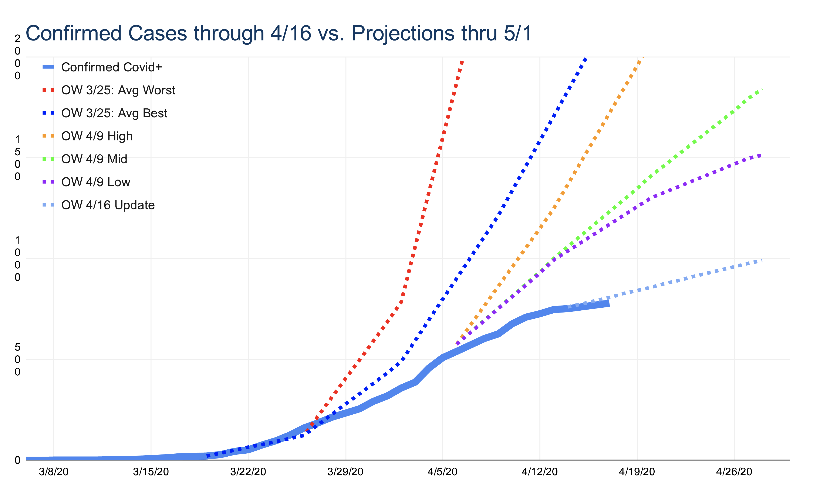
Forecasting vs. Actual Case Count
Source: Oliver Wyman (OW) April 16, 2020 Model

Slide 6
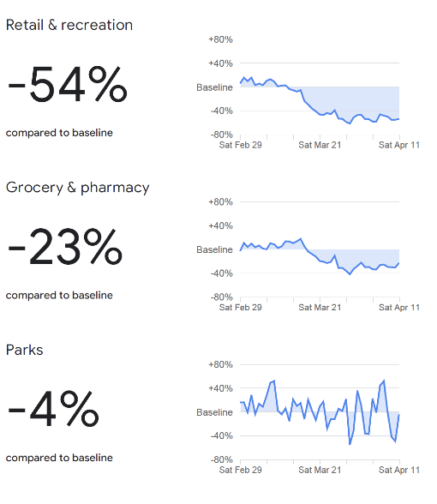
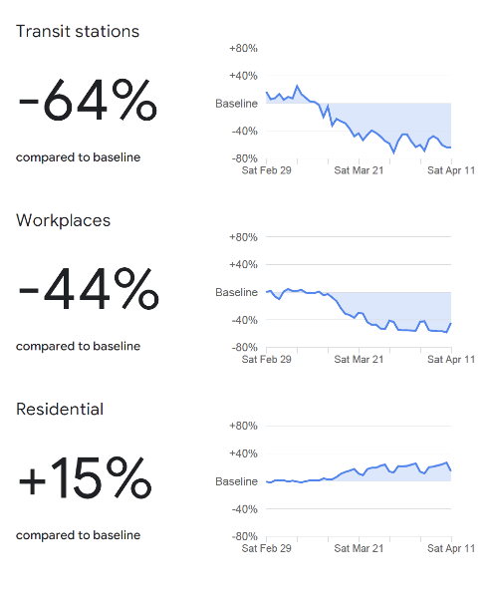
Vermont Mobility Data
Vermont April 11, 2020

Slide 7
Social Distancing Timing & Effect
Stay Home, Stay Safe
Closing Schools
Closing Bars & Restaurants
10 to 14-day delay
State of Emergency
Source: Oliver Wyman (OW) April 16, 2020 Model

Slide 8
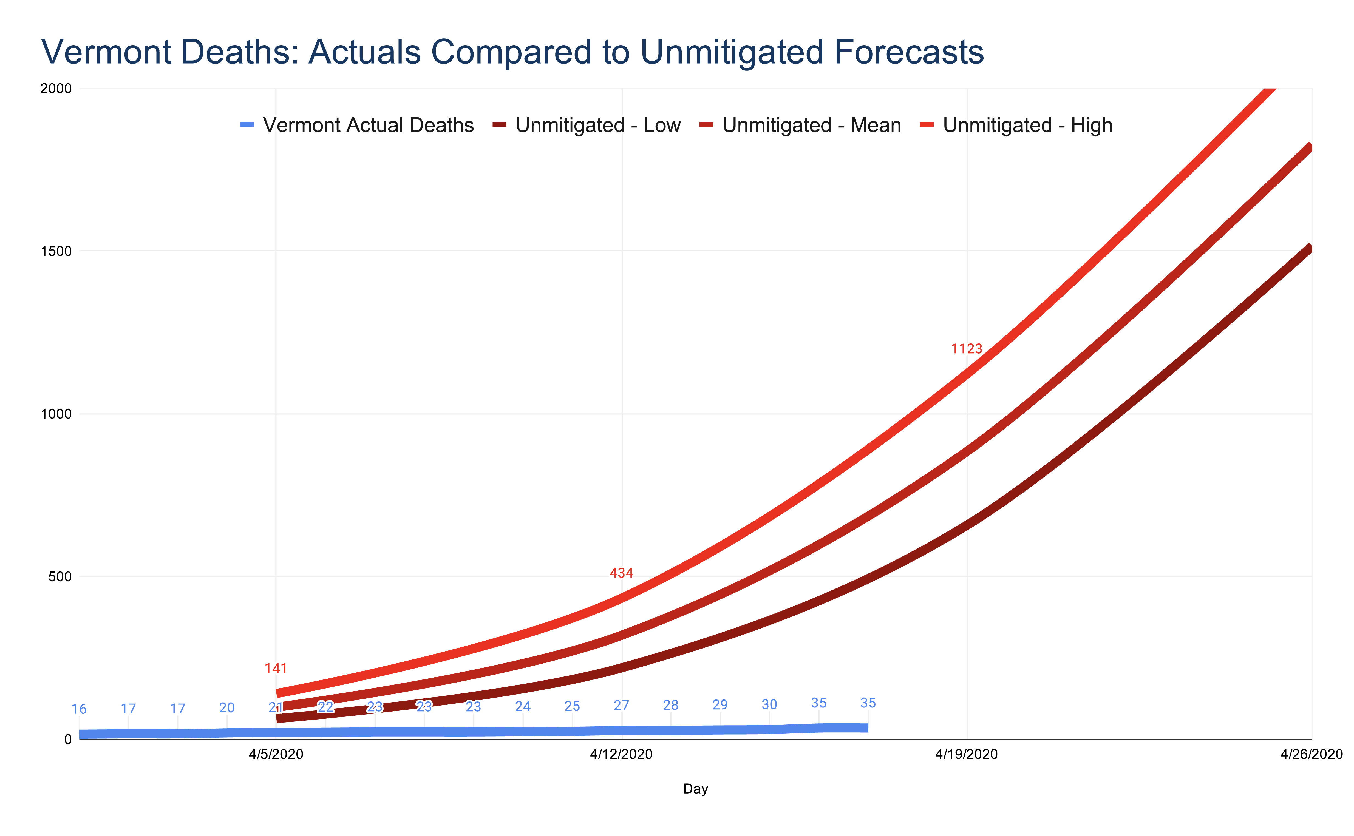
Forecast of Vermont Deaths
Source: Professor Vespignani April 3, 2020 Model

Slide 9
Hospitalization Needs – April 9th Trajectory

Slide 10
ICU Needs – April 9th Trajectory

Slide 11
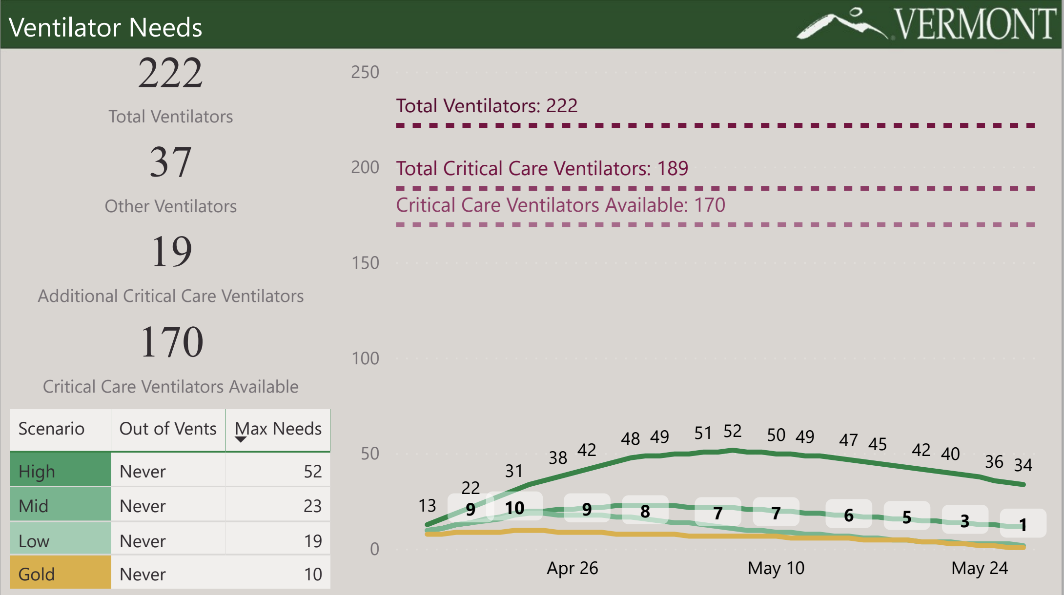
Ventilator Needs – April 9th Trajectory

