Slide 1
COVID-19 Model
Northeastern (Dr. Vespignani)
April 3, 2020
March 2020

Slide 2
Agenda:
1
Executive Summary
Hospitalization / ICU
Unmitigated vs. Mitigation Compare
Most Vulnerable
2
3
4

Slide 3
Executive Summary
Overall:
Vermont’s prompt action and compliance around mitigation strategies – essential, seeing impacts of mitigation policies in model
Vermont projected to be well prepared to combat virus
Compliance and ongoing mitigation policies critical
Modeling Summary: Assumes mitigation policies extended through end of April
Peak hospitalization and ICU expected in week of Apr 5, likely plateau for ~10 days
Virus cases do not exceed ICU capacity; peak load (~15-30 / day)
ICU Capacity is essential: people will likely survive if they can get care they need
65+ population most vulnerable
Total Deaths expected: ~30-100 by end of April
Next Steps:
Extend current mitigation policies through end of April (projected to save 1700+ lives)
Continue to aggressively enable surge capacity above projected ICU requirement
Reinforce reduced movement within Vermont – critical to slowing spread and saving lives
Update model weekly OR if there are unexpected changes (breakout in LTC facility, etc)
Revisit mid/end of April modeling on strategy to slowly lift restrictions – what is most effective approach and quantify impacts

Slide 4
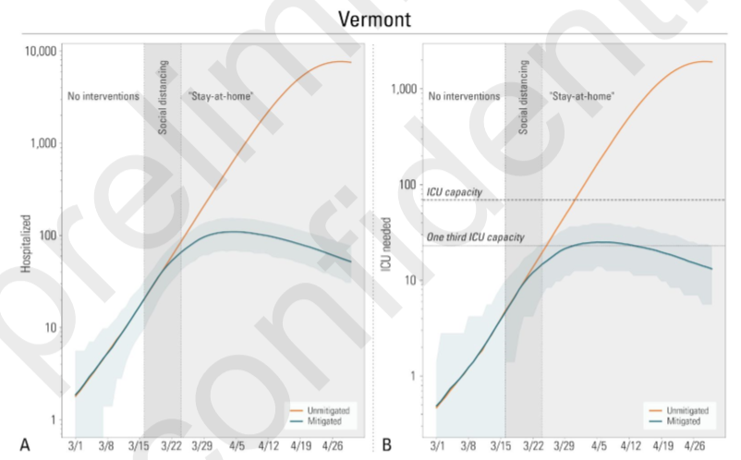
Model Results – Dr. Vespignani
4/03 actuals
Unmitigated
Mitigated
Hospitalization and ICU: Peak week Apr 5, plateau for ~10 days
* Assumes mitigation strategies in place through end of Apr

Slide 5
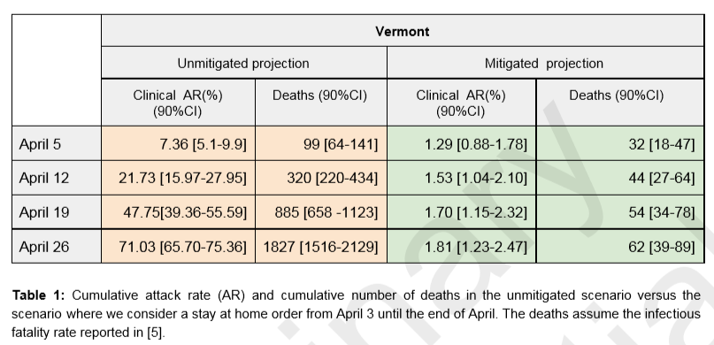
Model Results – Dr. Vespignani
Unmitigated vs. Mitigated Compare:
Total Deaths expected: ~30-100 by end of April with mitigation; saves 1500-2000 lives
~2% of population infected by end of April, (not herd immunity)
* Assumes mitigation strategies in place through end of Apr

Slide 6
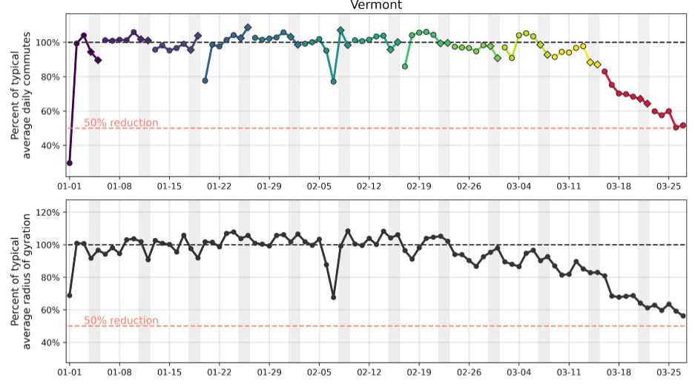
Mobility Reduction
Key Points:
1 : 50% Reduction in physical movement with mitigation policies in place
2. Dip on Feb 7 is the snow storm; this means people are moving around LESS than they did during the big snow storm → this is very good
1
2
Emergency Declaration
3/13
Stay at Home
3/24
1
2
Snow storm

Slide 7
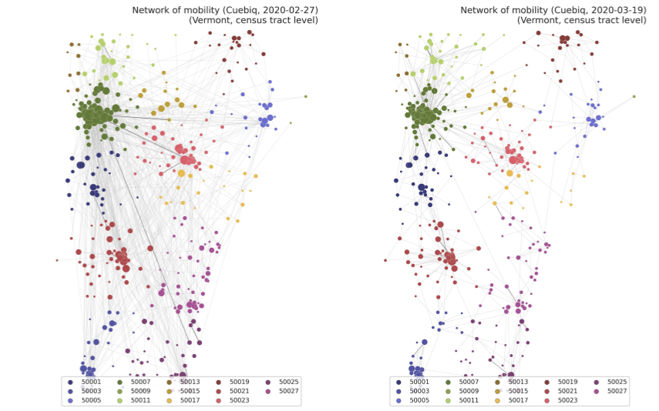
Network of Mobility by County
Key Points:
Shows the reduction in mobility from 2/27 – 3/19; people are moving around LESS
Reduction in movement evident by lack of gray lines from the metropolitan areas to other locations in the state

